Slide 1
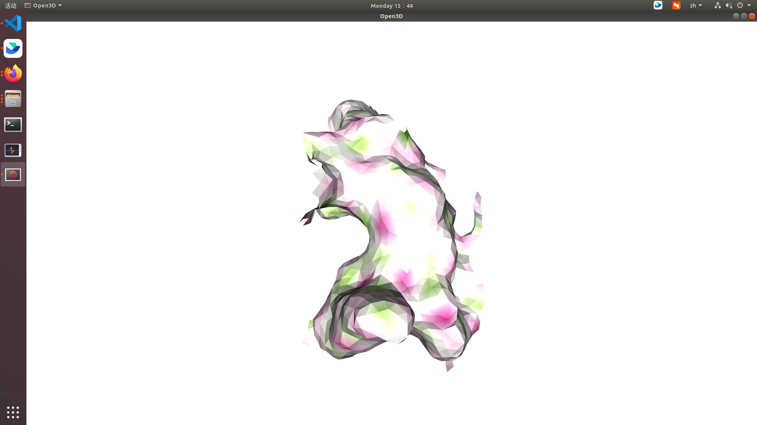
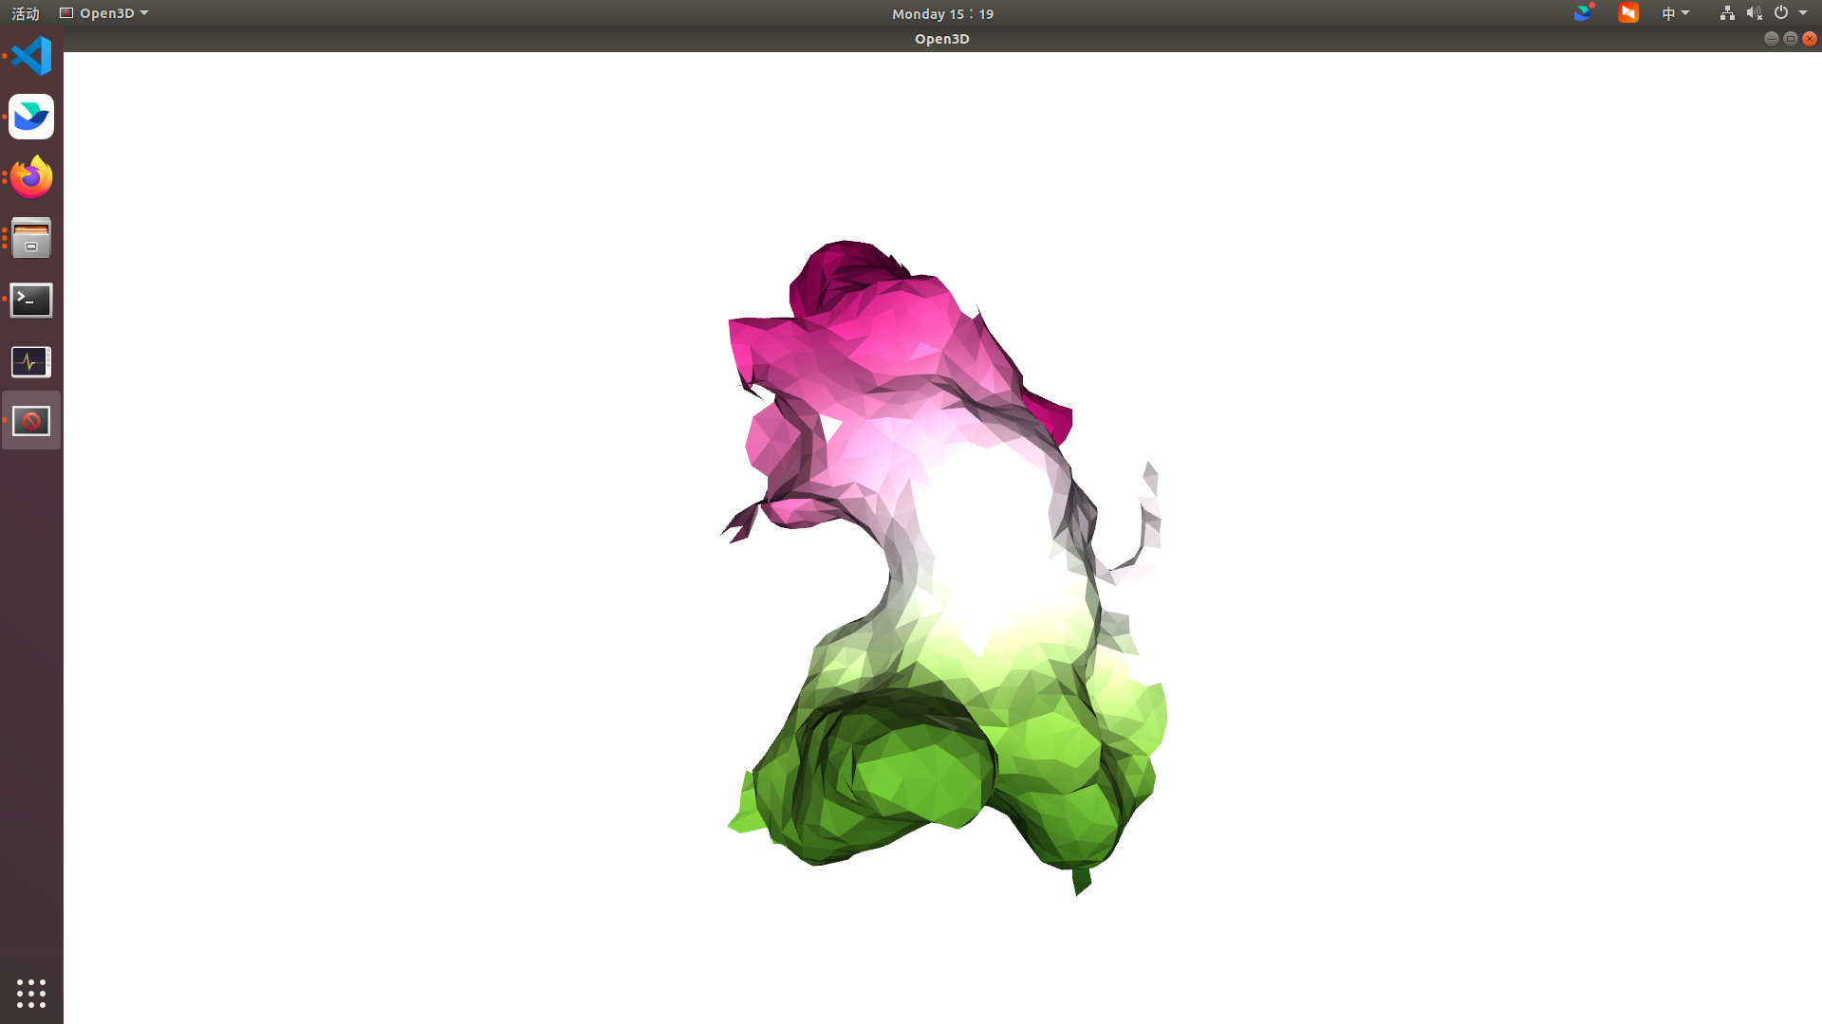
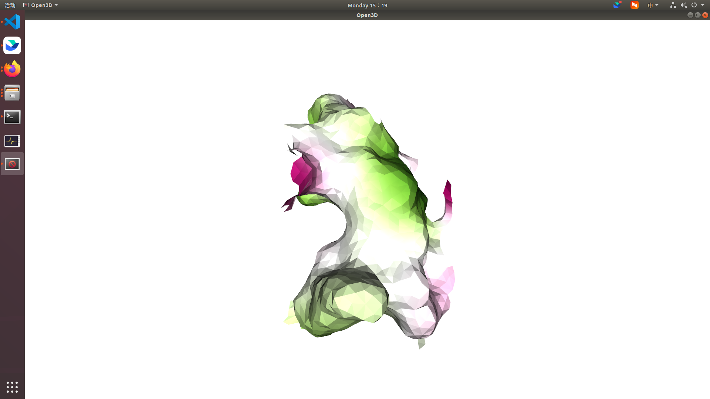
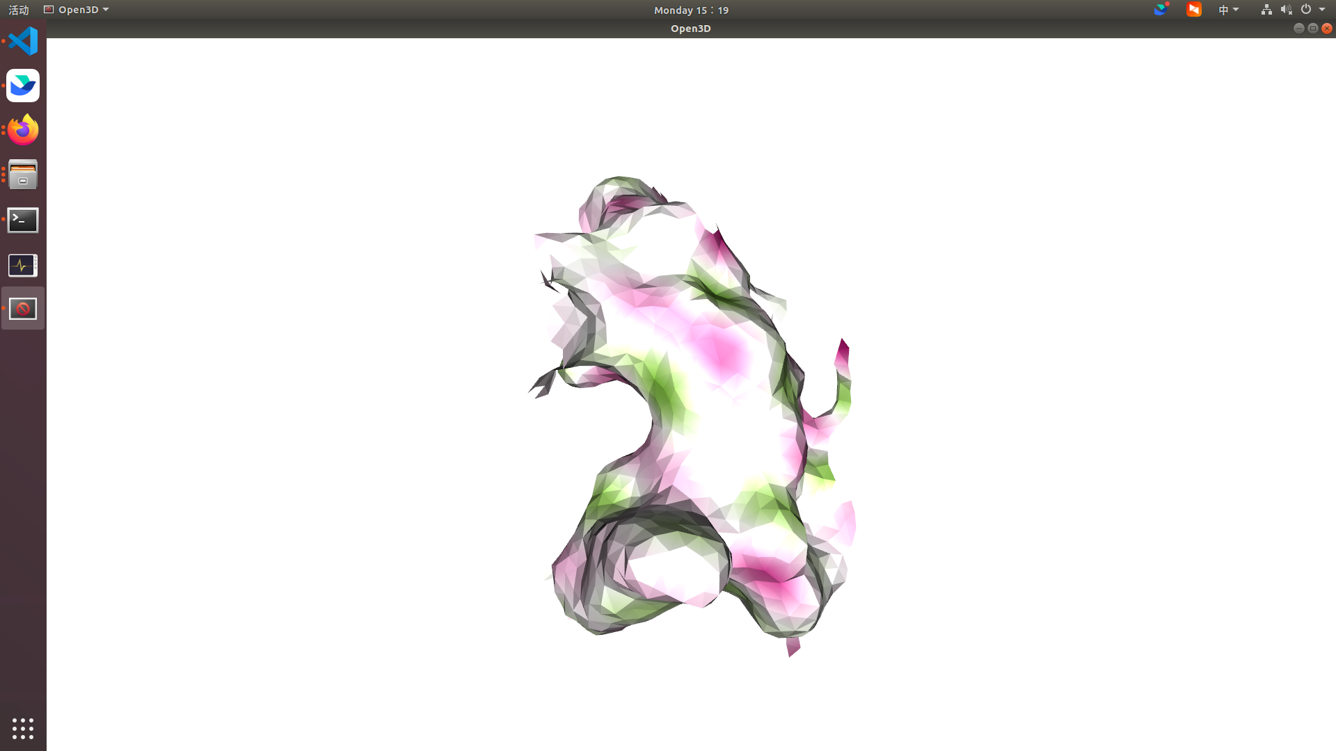




$$φ$$
$$c_{1}⋅φ_{1}$$
$$c_{2}⋅φ_{2}$$
$$c_{3}⋅φ_{3}$$

